Slide 1
Optimizing Pulse Shape Discrimination in a PEN Scintillator
Eli Ward
PHYS 594
Final Project

Slide 2
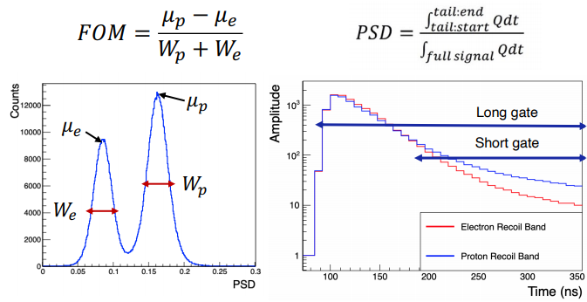
Pulse Shape Discrimination
Radiation entering scintillator triggers pulses of light
Scintillation pulses have different shapes for different incident radiation
Pulse Shape Discrimination (PSD) calculation can be used to distinguish between most, but not all, types of scintillation pulses
Project goal: to design a NN that can classify scintillation pulses that traditional PSD calculation cannot
Notes:
Delete FOM?

Slide 3
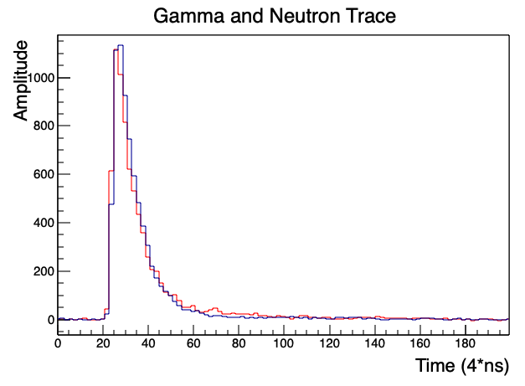
Data
Pulses in data come from either incident gamma rays or neutrons
20,000 pulses; half from gamma rays, half from neutrons
Each pulse is given as a histogram with 200 bins with width of 4 ns
“Good quality” data:
Energy deposition is 1 MeV to 4.5 MeV
“Medium quality” data:
Energy deposition is 450 KeV to 4.5 MeV
Low energy measurements cut out
Data is fed into NN as a list of lists
Each inner list is a single pulse
Corresponding list of labels
Labels each pulse as a gamma or neutron pulse
Gamma Trace
Neutron Trace
Notes:
Gammas and neutrons are the incident radiation

Slide 4

Binary Classification
Fed into NN randomly sorted list of gamma and neutron pulses
NN uses Keras API, Sequential model, Dense layers
Binary cross entropy cost function
Tried different batch sizes
Tried ReLU and sigmoid activation functions for each layer
Tried “tall and skinny” NN and “short and wide” NN
Added dropout layer

Slide 5
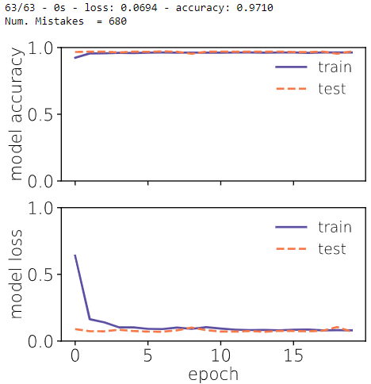
Results
Accuracy of NN was remarkably consistent:
“Good quality” data: >99% accuracy
“Medium quality” data: 95-97% accuracy
These accuracy ranges persisted for every hyperparameter value and NN shape that I tried
Only factor that seemed to improve “medium quality” data accuracy was adding a dropout (0.25) layer – by ~1%
NN appears to be relatively successful, but with not much room for improvement using current methods
As of yet do not have a good way to compare NN to traditional PSD calculation

Slide 6
References
Thank you to Yuri Efremenko, Brennan Hackett and Jesse Harris
B. Hackett, R. Toomey, “Measurement of Luminescent Properties of Polyethylene 2,6-Naphthalate,” (2021).
Hackett, Brennan. Scintillation and Optical Properties of the Low-Background Scintillator, PEN. 2021. PowerPoint Presentation.
J. Harris, “An A.I. Approach to Higgs Decay,” (2020).

